Slide 1
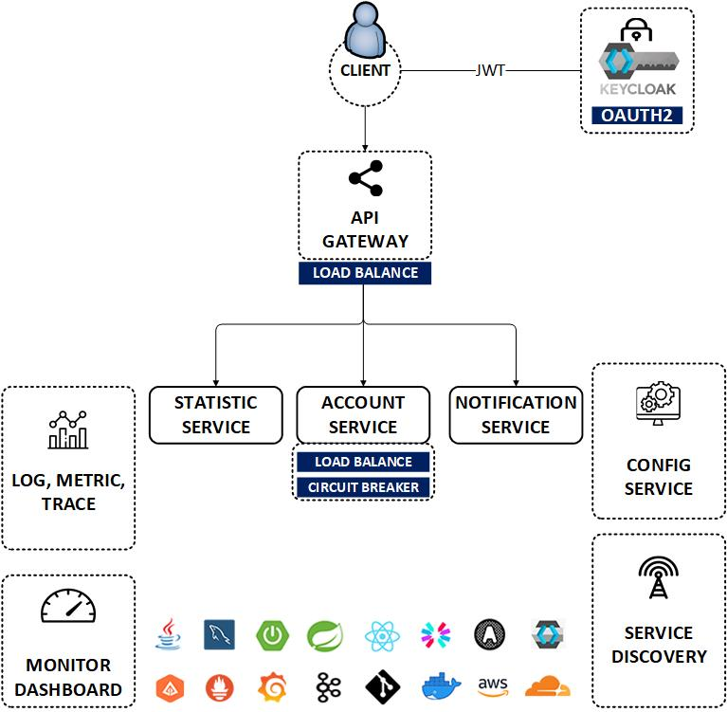


OpenID Connect Client Register (JDBC) (Spring Auth Server)
www.jmaster.io/course/microservices-with-spring-cloud

